Slide 1
3.4 Text Messaging
1-<number>

Slide 2
Transforming Lives in Developing Countries
M-PESA in Kenya
  Save money
  Pay bills
  Transfer funds
Communicate information about crop prices
Protect against counterfeit medicine
1-<number>

Slide 3
Twitter
Web-based social networking service
More than 200 million users
Blogging tool
Business promotion
Role in Arab Spring uprisings debated
  (+) Social networks lead to politicization
  (-) Ties in social networks too weak for high-risk activism
1-<number>

Slide 4
3.5 Censorship
1-<number>

Slide 5
Forms of Direct Censorship
Government monopolization
Prepublication review
Licensing and registration
1-<number>

Slide 6
Self-censorship
Most common form of censorship
Group decides for itself not to publish
Reasons
  Avoid subsequent persecution
  Maintain good relations with government officials (sources of information)
Ratings systems created to advise potential audience
  Movies, TVs, CDs, video games
  Not the Web
1-<number>

Slide 7
Challenges Posed by the Internet
Many-to-many communications
Dynamic connections
Huge numbers of Web sites
Extends beyond national borders, laws
Hard to distinguish between minors and adults
1-<number>

Slide 8
Governmental Filtering and Surveillance
Cuba, North Korea: Internet virtually inaccessible
Saudi Arabia: centralized control center
People’s Republic of China:
  Blocks Internet access at times of social unrest
  Has “one of most sophisticated filtering systems in the world”
Germany: Forbids access to neo-Nazi sites
United States: Have been repeated efforts to limit access of minors to pornography
1-<number>

Slide 9
Ethical Perspectives on Censorship
Kant opposed censorship
  Enlightenment thinker
  “Have courage to use your own reason”
Mill opposed censorship
  No one is infallible
  Any opinion may contain a kernel of truth
  Truth revealed in class of ideas
  Ideas resulting from discourse are more influential
1-<number>

Slide 10
Mill’s Principle of Harm
“The only ground on which intervention
is justified is to prevent harm to others;
the individual’s own good is not a
sufficient condition.”
1-<number>

Slide 11
3.6 Freedom of Expression
1-<number>

Slide 12
Freedom of Expression: History
De Scandalis Magnatum (England, 1275)
Court of Star Chamber
18th century
  No prior restraints on publication
  People could be punished for sedition or libel
American states adopted bills of rights including freedom of expression
Freedom of expression in 1st amendment to U.S. Constitution
1-<number>

Slide 13
1st Amendment to U.S. Constitution
Congress shall make no law respecting an
establishment of religion, or prohibiting the
free exercise thereof; or abridging the
freedom of speech, or of the press; or the
right of the people peaceably to assemble,
and to petition the government for a
redress of grievances.
1-<number>

Slide 14
Freedom of Expression
Not an Absolute Right
1st Amendment covers political and nonpolitical speech
Right to freedom of expression must be balanced against the public good
Various restrictions on freedom of expression exist
1-<number>

Slide 15
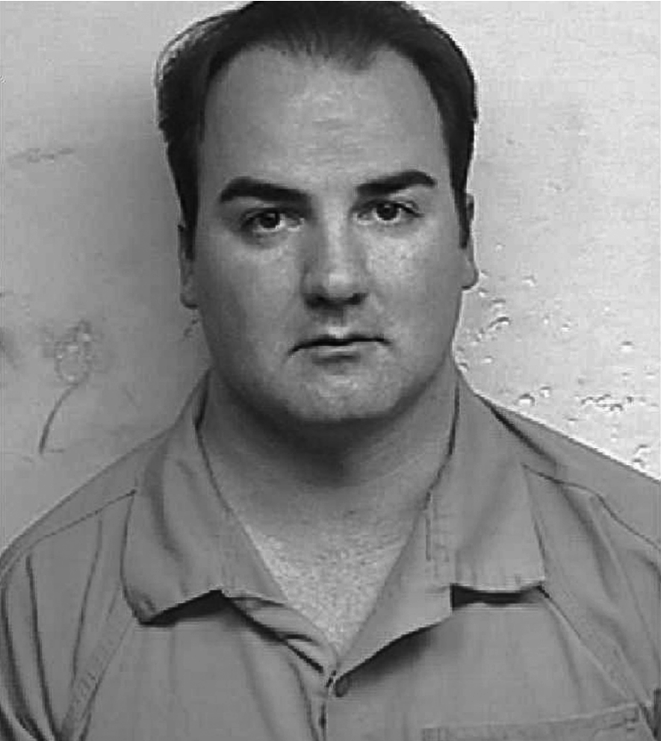
Jeremy Jaynes
AP Photo/Loudoun County Sheriff’s office
1-<number>

Slide 16
FCC v. Pacifica Foundation et al.
George Carlin records “Filthy Words”
WBAI in New York airs “Filthy Words” (1973)
FCC issues declaratory order to Pacifica
Pacifica sues
U.S. Supreme Court ruled FCC did not violate 1st Amendment (5-4 decision)
  Broadcast media “uniquely pervasive”
  Broadcasting uniquely accessible to children
1-<number>

Slide 17
Case Study: Kate’s Blog
Kate: Maintains a popular “life on campus” blog
Jerry: Another student; active in Whig Party
At private birthday party, someone gives Jerry a Tory Party T-shirt as a gag, and Jerry puts it on
Kate uses cell phone to take picture of Jerry when he isn’t looking, posts it on her blog
Story read by many people on and off campus
Jerry confronts Kate and demands she remove photo; she complies, and they remain friends
Kate’s blog and Jerry both become more popular
1-<number>

Slide 18
Kantian Analysis
Kate uploaded Jerry’s photo to her blog without asking his permission
She treated him as a means to her end of increasing the readership of her Web site
Her action was wrong
1-<number>

Slide 19
Social Contract Theory Analysis
Birthday party held in apartment of one of Jerry’s friends
Jerry had a reasonable expectation of privacy
Kate violated Jerry’s right to privacy
Kate’s action was wrong
1-<number>

Slide 20
Act Utilitarian Analysis
Benefits
  Popularity of Kate’s blog increased (definitely)
  Jerry become more popular on campus (definitely)
Harms
  Jerry’s anger at Kate (only temporary)
  Photo could discredit Jerry at some point in future (unlikely)
Benefits greater than harms, so Kate did a good thing
1-<number>

Slide 21
Rule Utilitarian Analysis
What if everyone were constantly taking photos of people they encountered and posting them?
Positive consequences
  People would have more opportunities to keep up with what their friends are doing
  People might be more reluctant to engage in illegal activities
Negative consequences
  People would become more self-conscious
  Some relationships would be harmed
Negative consequences more weighty than positive consequences, so Kate’s action was bad
1-<number>

